Slide 1
Reinforcement Learning with Human Feedback

Slide 2
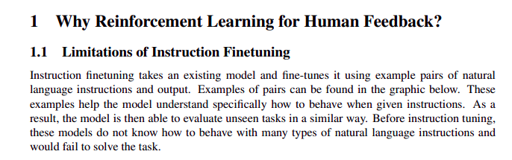

Slide 3
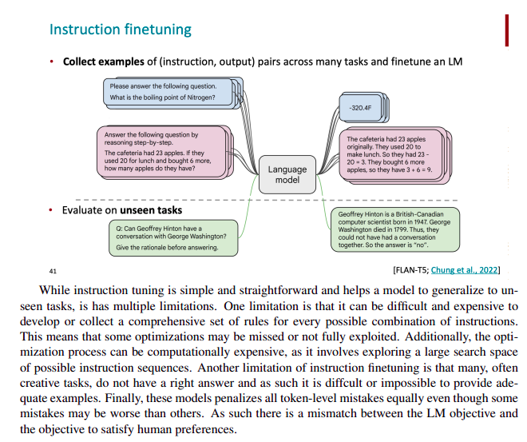

Slide 4
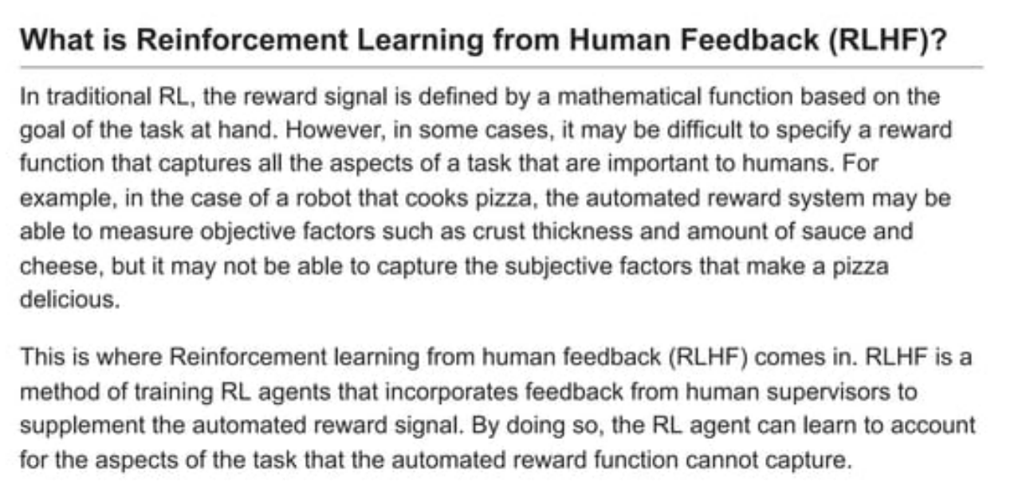

Slide 5
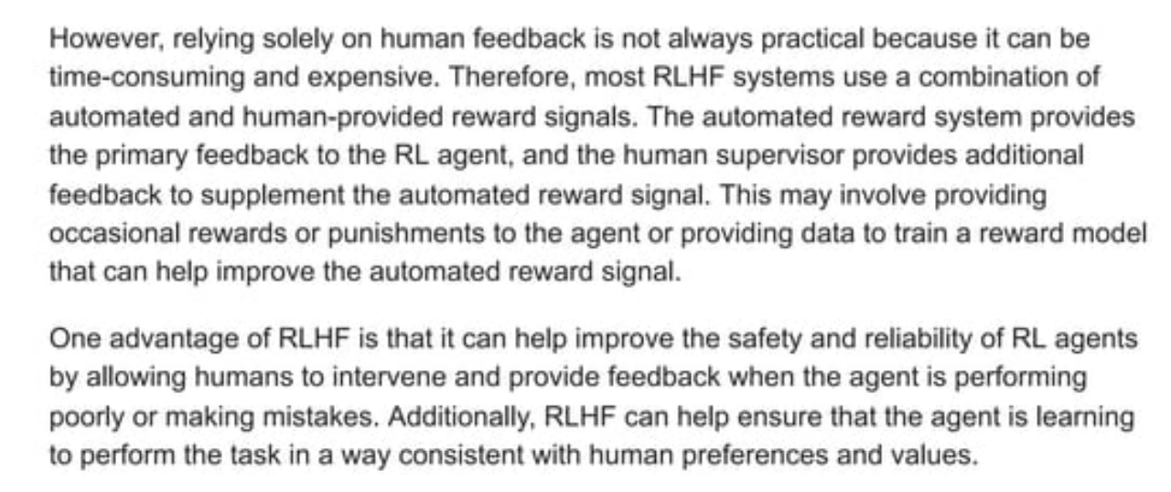

Slide 6
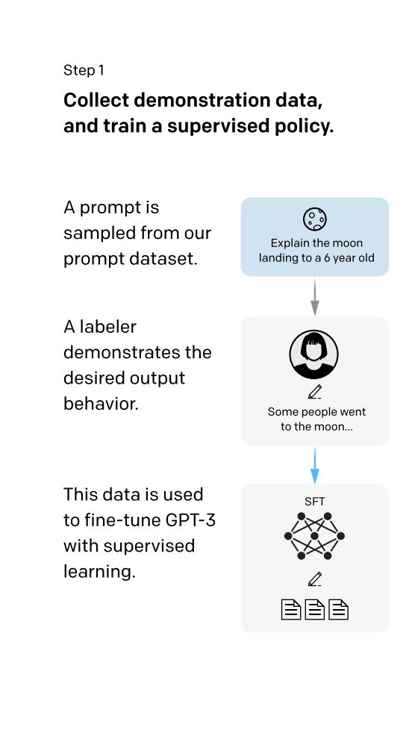
Training language models to follow instructions with human feedback
Step 1:
Collect demonstration data from users .
The labelers provide demonstrations of the desired behavior on the input prompt distribution.
Then, a pretrained GPT-3 model is fine-tuned on this data using supervised learning

Slide 7
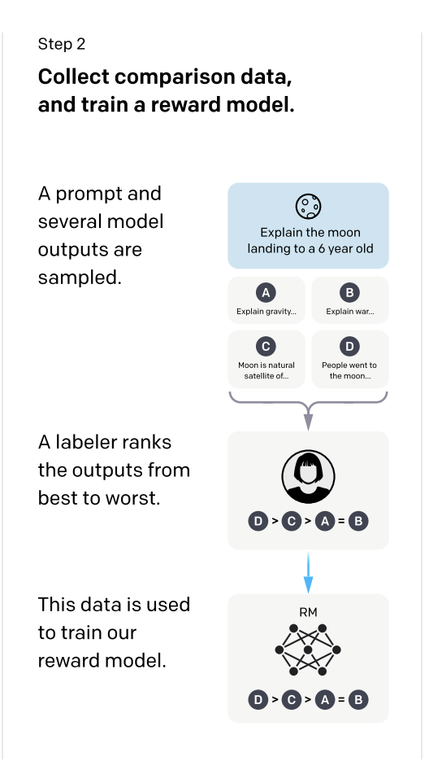
Training language models to follow instructions with human feedback
Step 2:
Collect comparison data, and train a reward model.
A dataset of comparisons between model outputs is collected, where labelers indicate which output they prefer for a given input.
Then, a reward model is trained to predict the human-preferred output

Slide 8
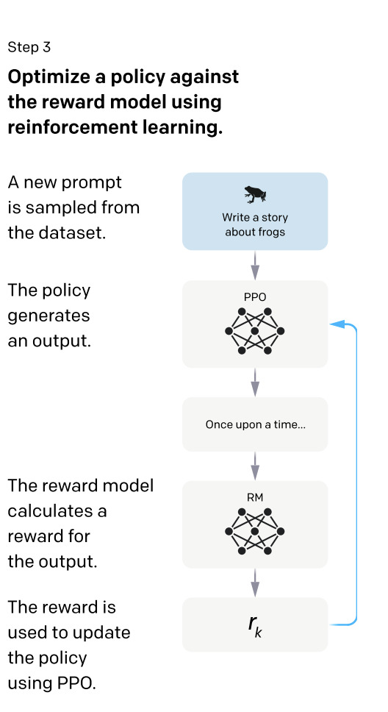
Training language models to follow instructions with human feedback
Step 3:
A policy is optimized against the reward model using PPO.
The output of the RM is used as a scalar reward.
The supervised policy is fine-tuned to optimize this reward using the PPO algorithm

Slide 9
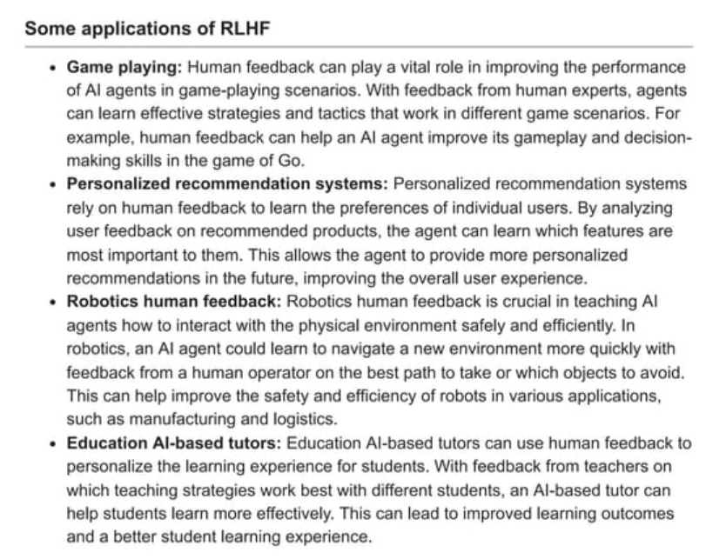

Slide 10
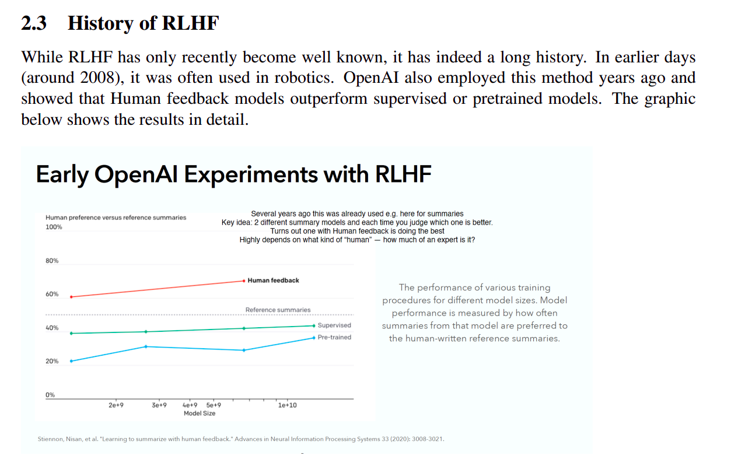

Slide 11
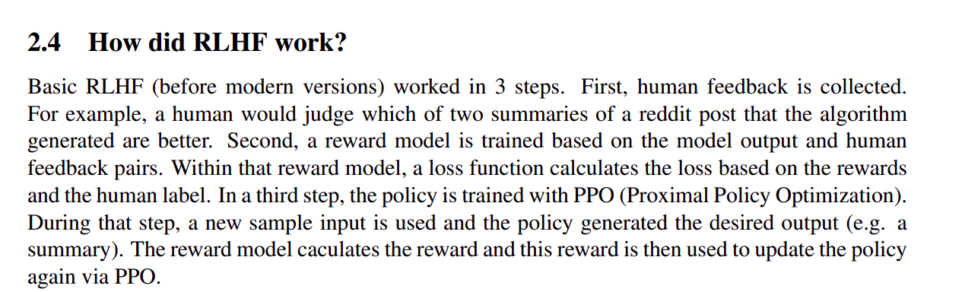
Continued to Next Slide

Slide 12
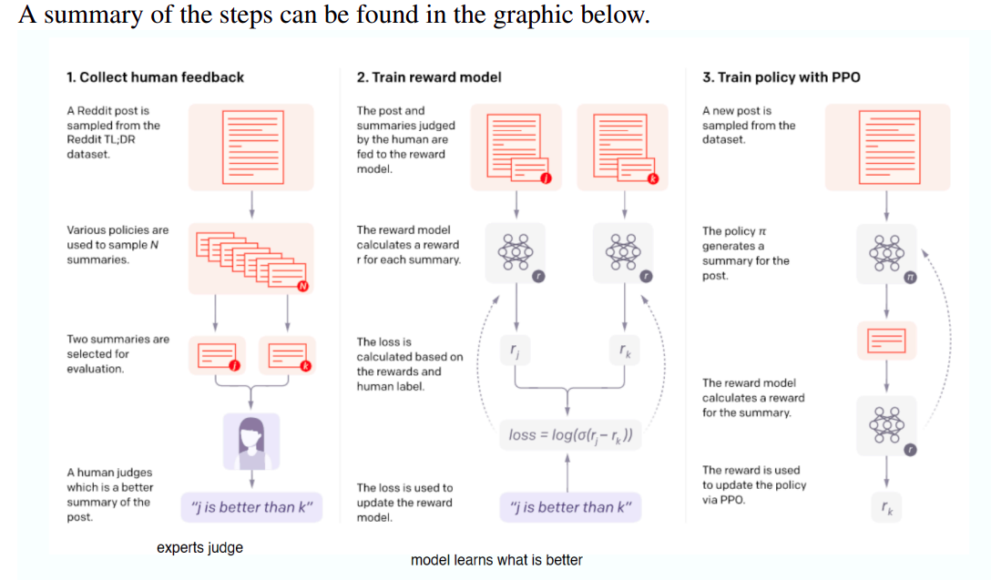

Slide 13
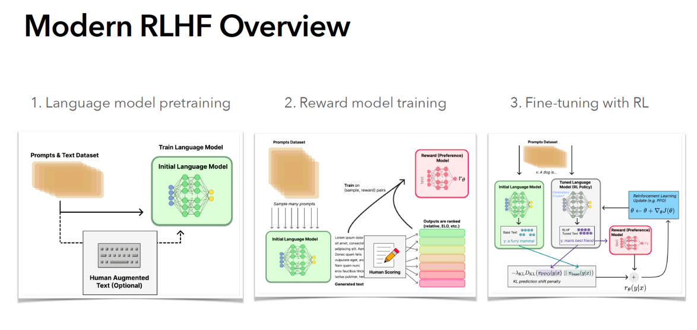

Slide 14
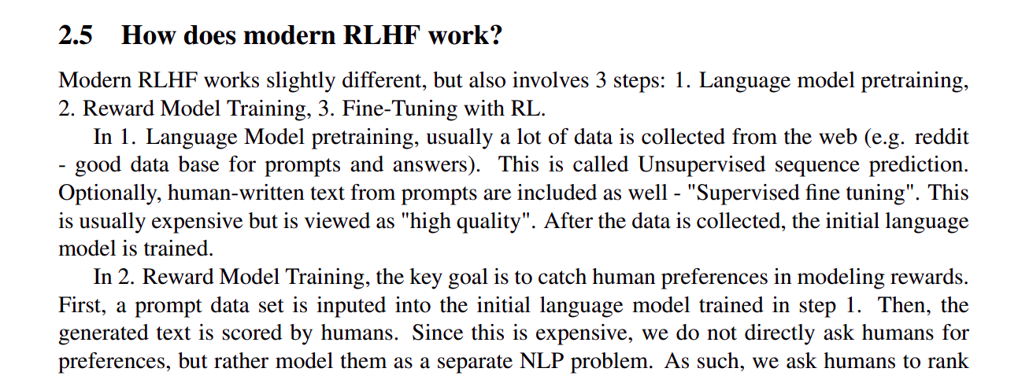
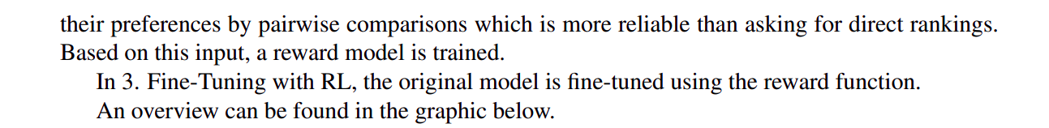

Slide 15
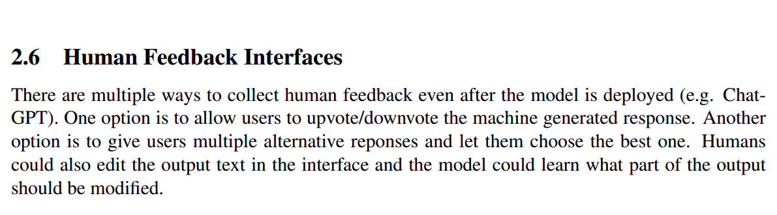

Slide 16
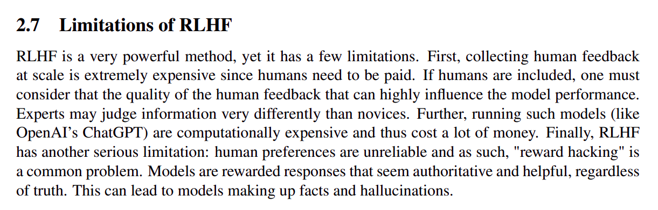

Slide 17
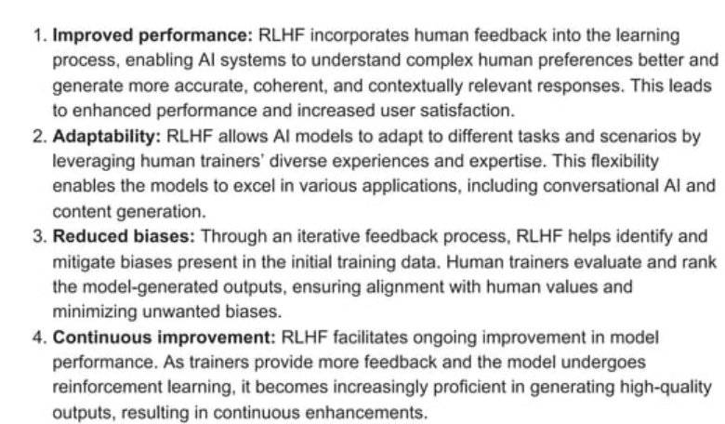
Benefits of RLHF

Slide 18
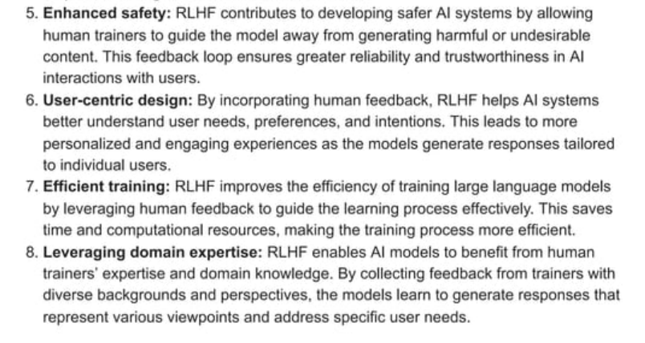
Benefits of RLHF

Slide 19
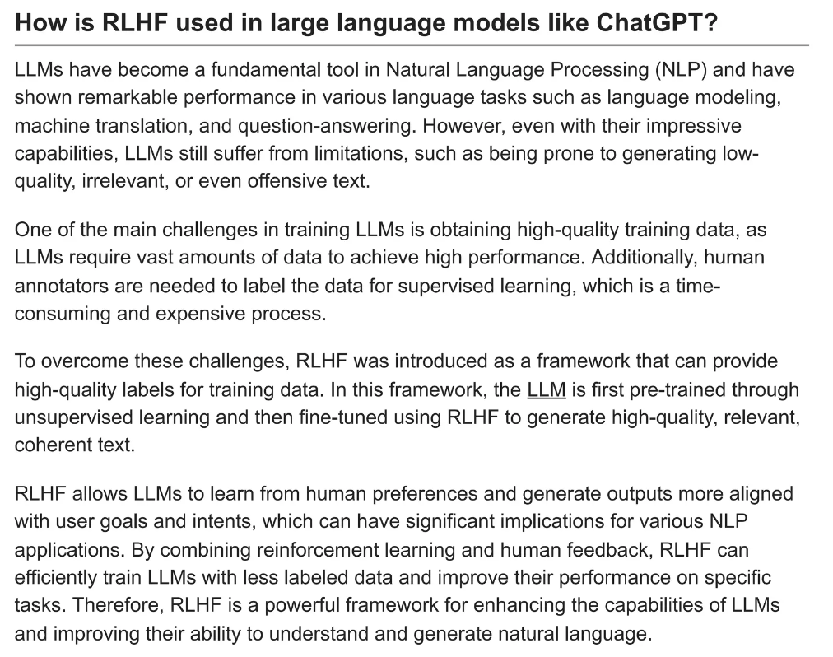

Slide 20
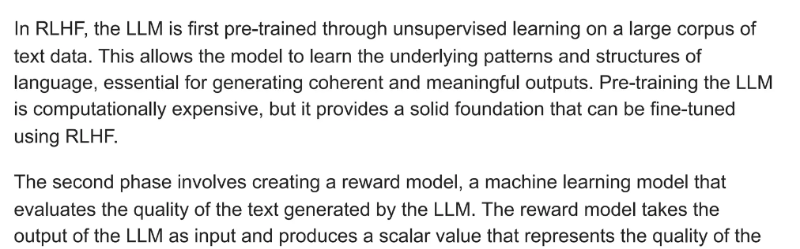
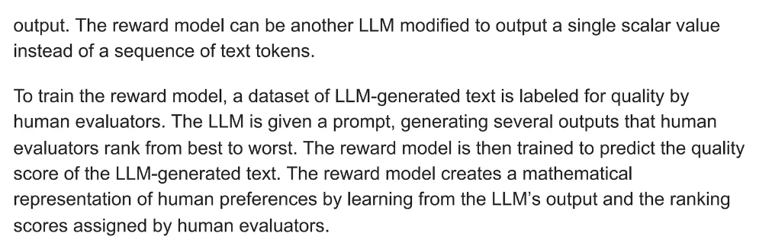

Slide 21
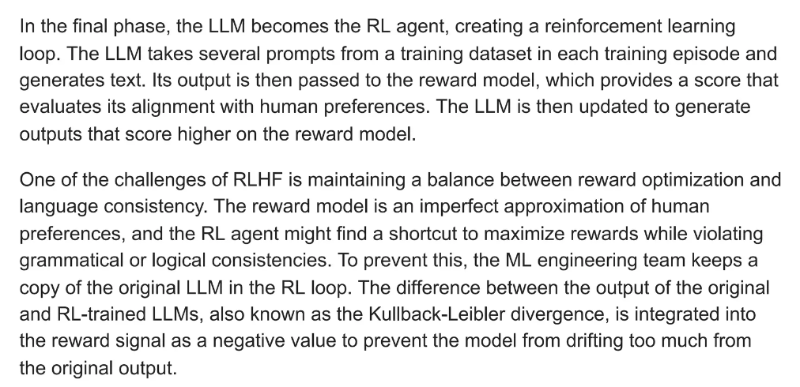

Slide 22
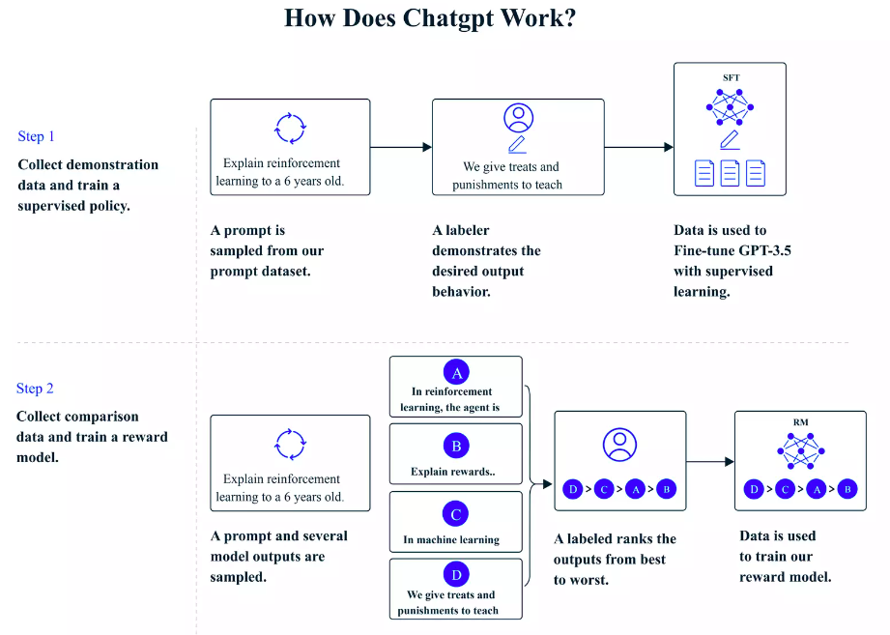

Slide 23
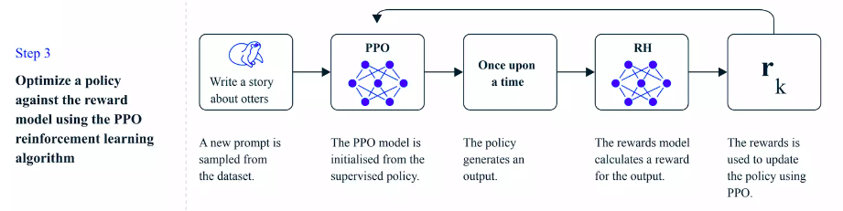
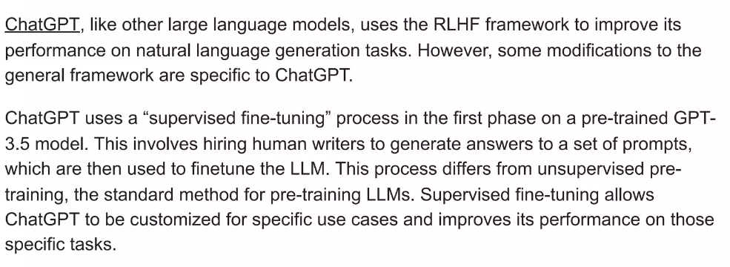

Slide 24
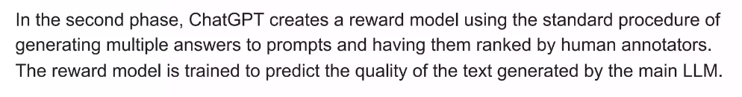
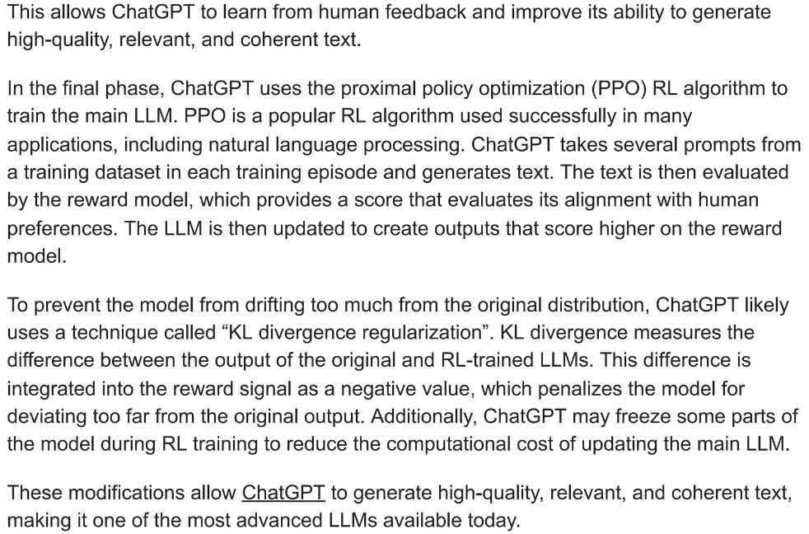

Slide 25
